Slide 1
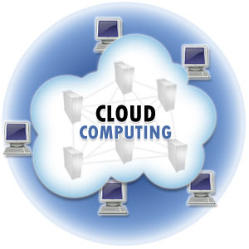
Cloud
the word cloud (also phrased as "the cloud") is used as a metaphor for "the Internet.

Slide 2
Cloud Computing
Cloud Computing is a general term used to describe a new class of network based computing that takes place over the Internet,
basically a step on from Utility Computing
a collection/group of integrated and networked hardware, software and Internet infrastructure (called a platform).
Using the Internet for communication and transport provides hardware, software and networking services to clients

Slide 3
Cloud Computing
These platforms hide the complexity and details of the underlying infrastructure from users and applications by providing very simple graphical interface or API (Applications Programming Interface).

Slide 4
Cloud Computing
In addition, the platform provides on demand services, that are always on, anywhere, anytime and any place.
Pay for use and as needed, elastic
scale up and down in capacity and functionalities
The hardware and software services are available to
general public, enterprises, corporations and businesses markets

Slide 5
Cloud Summary
Cloud computing is an umbrella term used to refer to Internet based development and services
A number of characteristics define cloud data, applications services and infrastructure:
Remotely hosted: Services or data are hosted on remote infrastructure.
Ubiquitous: Services or data are available from anywhere.
Commodified: The result is a utility computing model similar to traditional that of traditional utilities, like gas and electricity - you pay for what you would want!

Slide 6
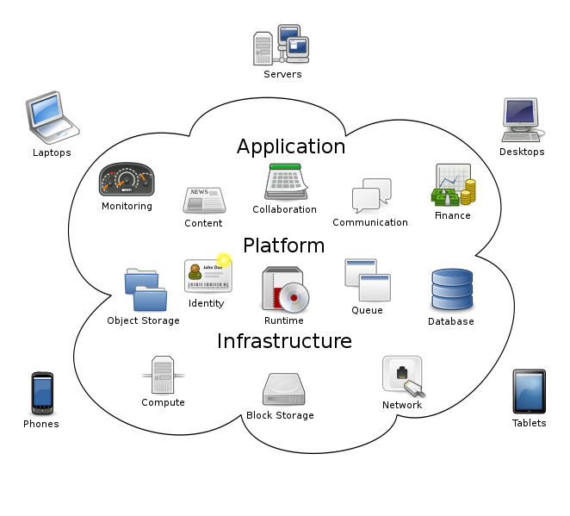

Slide 7
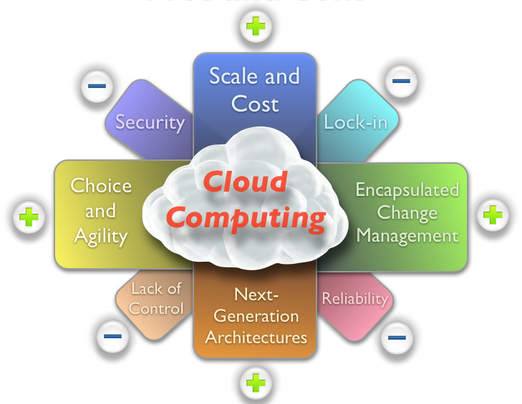
Pros and Cons

Slide 8
The Emergence of Cloud Computing
“When was it invented?”
“When was it first mentioned?”
“What are the prospects for its future?”

Slide 9
Emergence of Cloud Computing contd.
It was a gradual evolution that started in the 1950s with mainframe computing.
Because of the costs to buy and maintain mainframe computers, it was not practical for an organization to buy and maintain one for every employee.
Providing shared access to a single resource was the solution that made economical sense for this sophisticated piece of technology.
After some time, around 1970, the concept of virtual machines (VMs) was created.
Using virtualization software like VMware, it became possible to execute one or more operating systems simultaneously in an isolated environment.

Slide 10
Emergence of Cloud Computing contd.
In the 1990s, telecommunications companies started offering virtualized private network connections.
Historically, telecommunications companies only offered single dedicated point–to-point data connections. The newly offered virtualized private network connections had the same service quality as their dedicated services at a reduced cost. Instead of building out physical infrastructure to allow for more users to have their own connections.

Slide 11
Emergence of Cloud Computing contd.
In 1997, Professor Ramnath Chellapa of Emory University and the University of South California defined cloud computing as “The new computing paradigm where the boundaries of computing will be determined by economic rationale rather than technical limits alone.”
One of the first milestones for cloud computing was the arrival of Salesforce.com in 1999
which pioneered the concept of delivering enterprise applications via a simple website. The services firm paved the way for both specialist and mainstream software firms to deliver applications over the internet.

Slide 12
Emergence of Cloud Computing contd.
In 2002 Amazon Web services was developed, Further more in 2006 Elastic compute cloud (EC2) was launched as a commercial web service that allows small companies or individuals to rent virtual computers on their own.
Another big milestone came in 2009, as Web 2.0 hit its stride, and Google and others started to offer browser-based enterprise applications, though services such as Google Apps.

Slide 13
Evolution of Cloud Computing

Slide 14
Type of cloud computing
There are mainly three type of cloud computing service models
Infrastructure as a service (Iaas)
Platform as a service (Pass)
Software as a service (Saas)

Slide 15
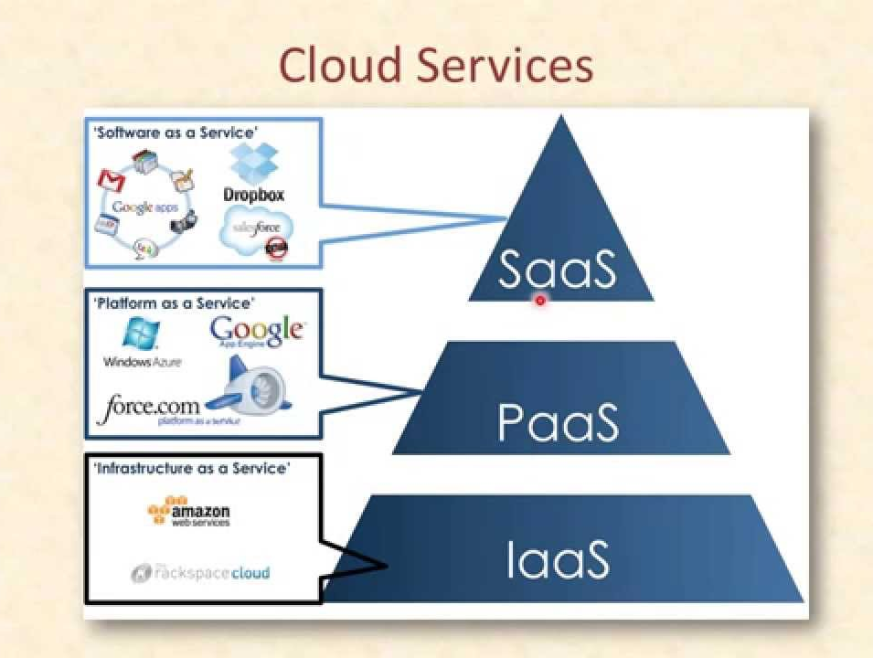
Notes:
Open data collect (ODK), word online, google docs

Slide 16
Infrastructure as a Service
Infrastructure as a Service - IaaS
The capability provided to the consumer is to provision processing, storage, networks, and other fundamental computing resources where the consumer is able to deploy and run arbitrary software, which can include operating systems and applications.
The consumer does not manage or control the underlying cloud infrastructure but has control over operating systems, storage, deployed applications, and possibly limited control of select networking components .
Examples :
Amazon EC2
OpenNebula
RackSpace cloud
… etc

Slide 17
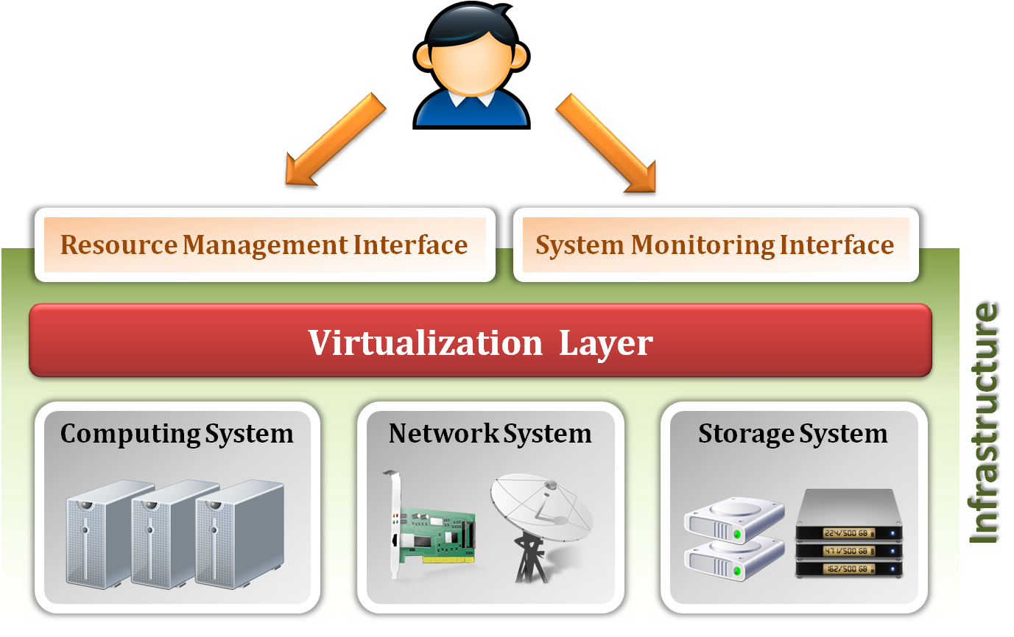
Infrastructure as a Service
System architecture :

Slide 18
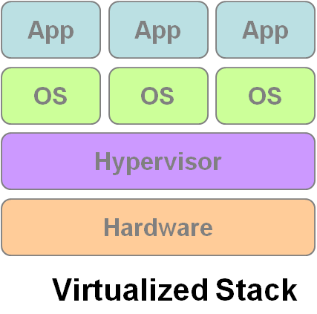
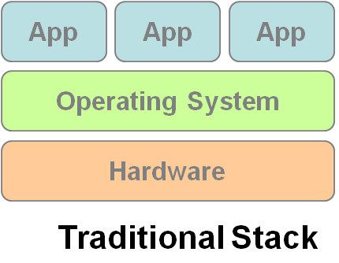
Infrastructure as a Service
Enabling technique - Virtualization
Virtualization is an abstraction of logical resources, away from underlying physical resources.
Virtualization technique shift OS onto hypervisor.
Multiple OS share the physical hardware and provide different services.
Improve utilization, availability, security and convenience.
VM1
VM2
VM3

Slide 19
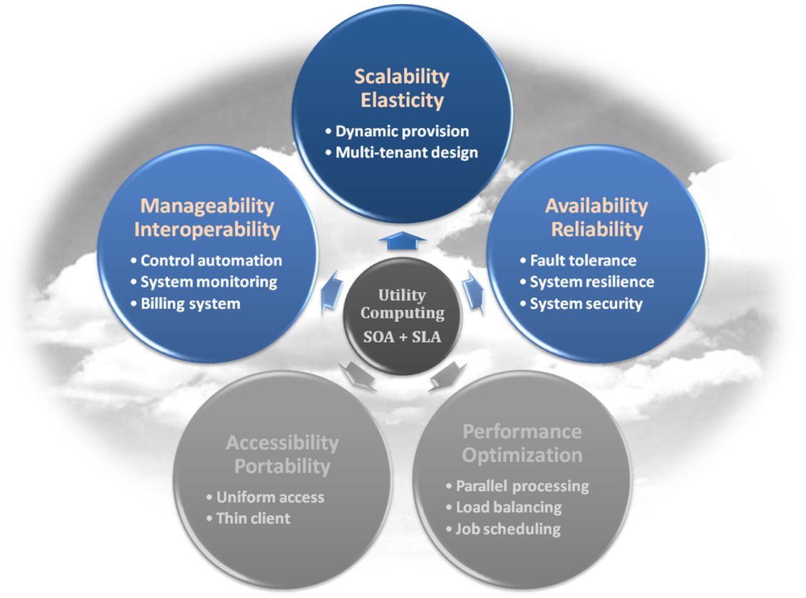
Infrastructure as a Service
Properties supported by virtualization technique :
Manageability and Interoperability
Availability and Reliability
Scalability and Elasticity

Slide 20
Infrastructure as a Service
Provide service –Resource Management Interface
Several types of virtualized resource :
Virtual Machine – As an IaaS provider, we should be able to provide the basic virtual machine operations, such as creation, suspension, resumption and termination, …etc.
Virtual Storage – As an IaaS provider, we should be able to provide the basic virtual storage operations, such as space allocation, space release, data writing and data reading, …etc.
Virtual Network – As an IaaS provider, we should be able to provide the basic virtual network operations, such as IP address allocation, domain name register, connection establishment and bandwidth provision, …etc.

Slide 21
Infrastructure as a Service
Provide service – System Monitoring Interface
Several types of monitoring metrics :
Virtual Machine – As an IaaS provider, we should be able to monitor some system states of each virtual machine, such as CPU loading, memory utilization, IO loading and internal network loading, …etc.
Virtual Storage – As an IaaS provider, we should be able to monitor some storage states of each virtual storage, such as virtual space utilization, data duplication and storage device access bandwidth, …etc.
Virtual Network – As an IaaS provider, we should be able to monitor some network states of each virtual network, such as virtual network bandwidth, network connectivity and network load balancing, …etc.

Slide 22
IaaS - Summary
IaaS is the deployment platform that abstract the infrastructure.
IaaS enabling technique
Virtualization
Server Virtualization
Storage Virtualization
Network Virtualization
IaaS provided services
Resource Management Interface
System Monitoring Interface

Slide 23
Platform as a Service
Platform as a Service - PaaS
The capability provided to the consumer is to deploy onto the cloud infrastructure consumer-created or acquired applications created using programming languages and tools supported by the provider.
The consumer does not manage or control the underlying cloud infrastructure including network, servers, operating systems, or storage, but has control over the deployed applications and possibly application hosting environment configurations.
Examples :
Microsoft Windows Azure
Google App Engine
Hadoop
Force.com
… etc

Slide 24
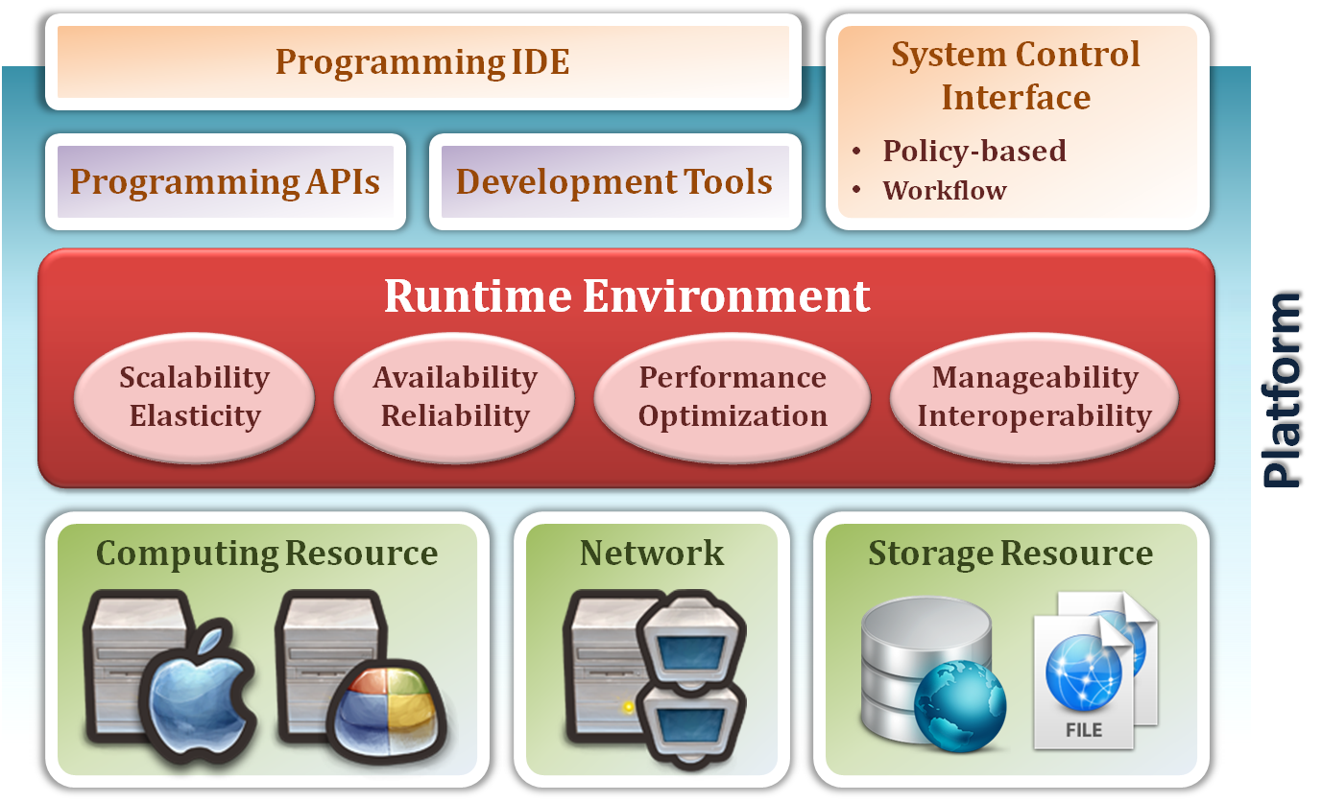
Platform as a Service
System architecture :

Slide 25
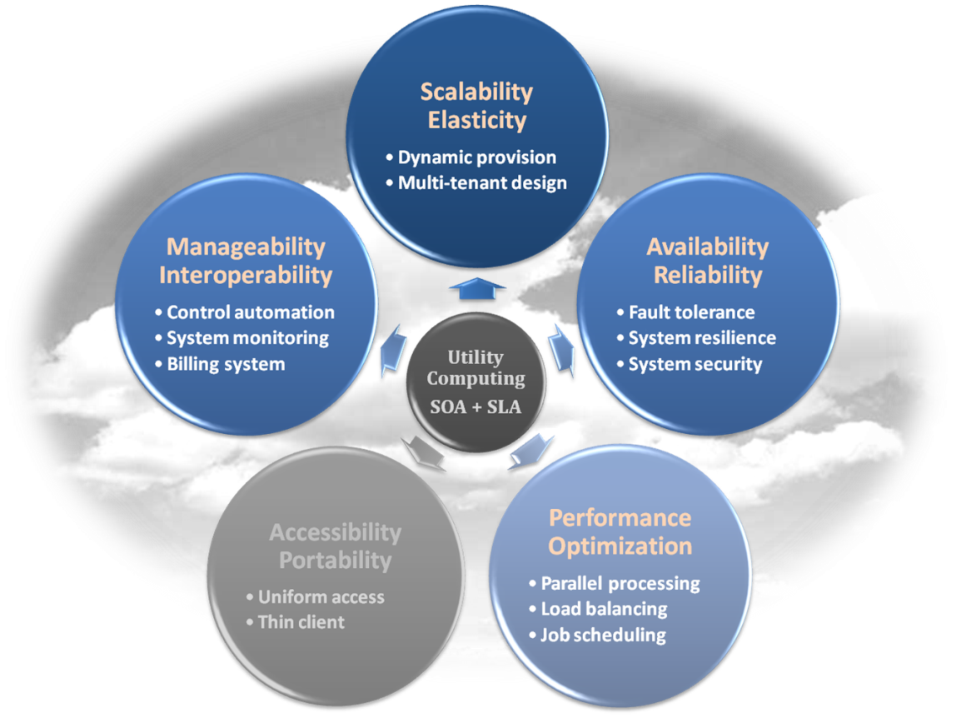
Platform as a Service
Enabling technique – Runtime Environment Design
Runtime environment refers to collection of software services available. Usually implemented by a collection of program libraries.
Common properties in Runtime Environment :
Manageability and Interoperability
Performance and Optimization
Availability and Reliability
Scalability and Elasticity

Slide 26
Platform as a Service
Provide service – Programming IDE
Users make use of programming IDE to develop their service among PaaS.
This IDE should integrate the full functionalities which supported from the underling runtime environment.
This IDE should also provide some development tools, such as profiler, debugger and testing environment.
The programming APIs supported from runtime environment may be various between different cloud providers, but there are still some common operating functions.
Computation, storage and communication resource operation

Slide 27
Platform as a Service
Provide service – System Control Interface
Policy-Based Control
Typically described as a principle or rule to guide decisions and achieve rational outcome(s)
Make the decision according to some requirements
Workflow Control
Describe the flow of installation and configuration of resources
Workflow processing daemon delivers speedy and efficient construction and management of cloud resources

Slide 28
PaaS - Summary
PaaS is the development platform that abstract the infrastructure, OS, and middleware to drive developer productivity.
PaaS enabling technique
Runtime Environment
PaaS provide services
Programming IDE
Programming APIs
Development tools
System Control Interface
Policy based approach
Workflow based approach

Slide 29
Software as a Service
Software as a Service - SaaS
The capability provided to the consumer is to use the provider’s applications running on a cloud infrastructure. The applications are accessible from various client devices through a thin client interface such as a web browser (e.g., web-based email).
The consumer does not manage or control the underlying cloud infrastructure including network, servers, operating systems, storage, or even individual application capabilities, with the possible exception of limited user-specific application configuration settings.
Examples :
Google Apps (e.g., Gmail, Google Docs, Google sites, …etc)
SalesForce.com
EyeOS
… etc

Slide 30
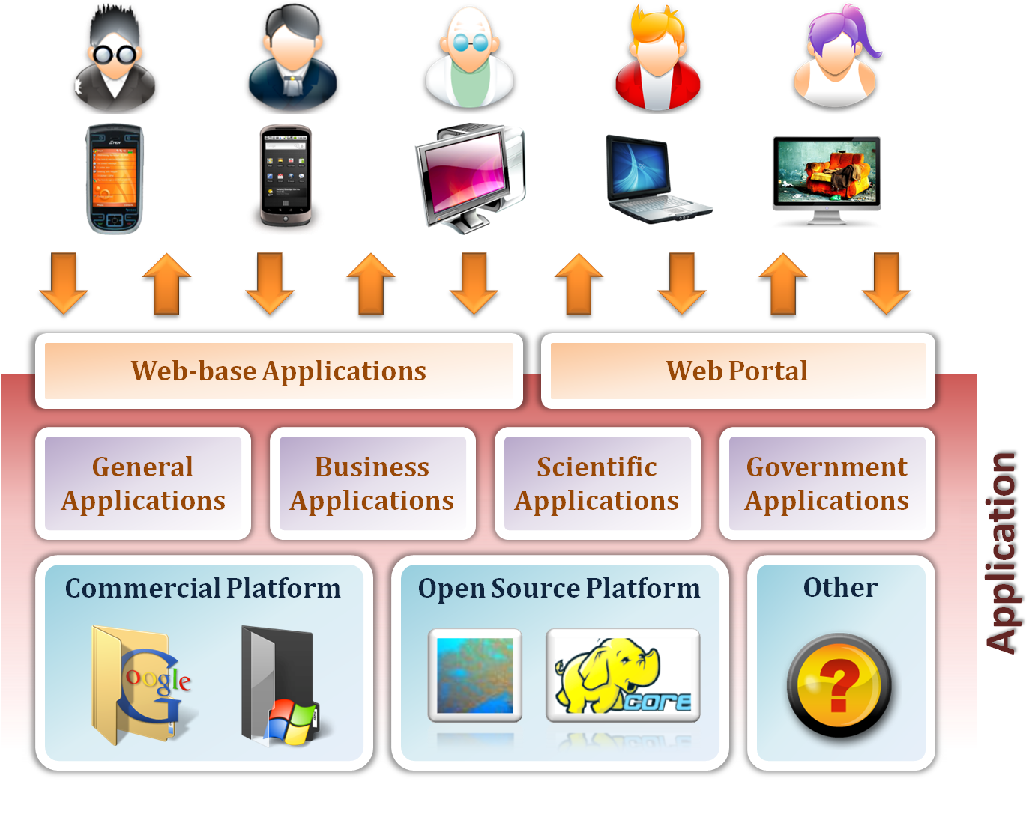
Software as a Service

Slide 31
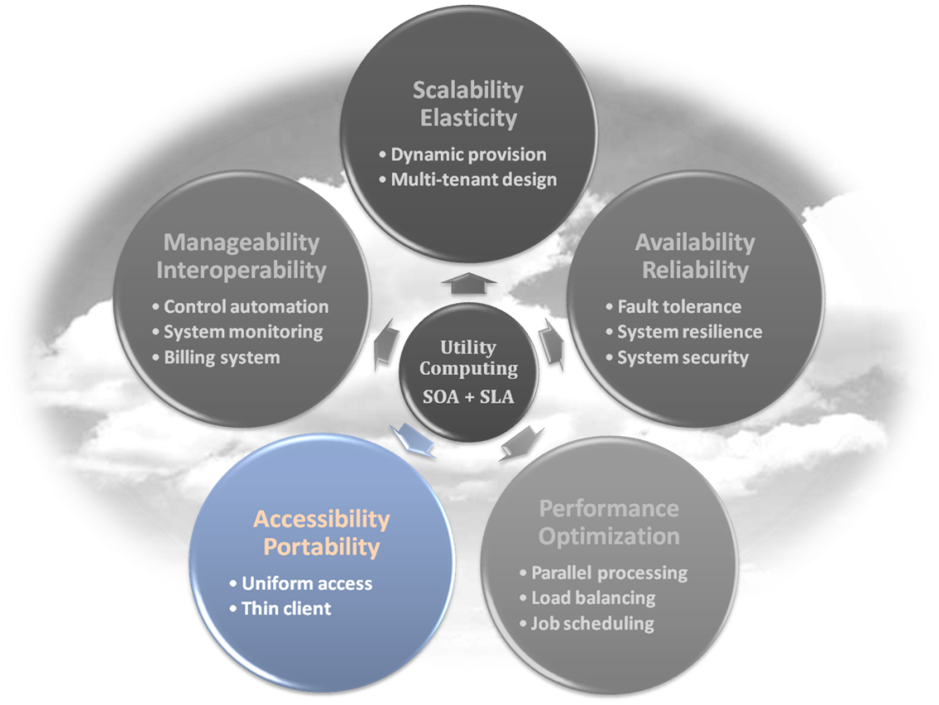
Software as a Service
Enabling Technique – Web Service
Web 2.0 is the trend of using the full potential of the web
Viewing the Internet as a computing platform
Running interactive applications through a web browser
Leveraging interconnectivity and mobility of devices
Enhanced effectiveness with greater human participation
Properties provided by Internet :
Accessibility and Portability

Slide 32
Software as a Service
Provide service – Web-based Applications
Conventional applications should translate their access interface onto web-based platform.
Applications in different domains
General Applications – Applications which are designed for general propose, such as office suit, multimedia and instant message, …etc.
Business Applications – Application which are designed for business propose, such as ERP, CRM and market trading system, …etc.
Scientific Applications – Application which are designed for scientific propose, such as aerospace simulation and biochemistry simulation, …etc.
Government Applications – Applications which are designed for government propose, such as national medical system and public transportation system service, …etc.
Notes:
ERP-enterprise resource planning

Slide 33
Software as a Service
Provide service – Web Portal
Apart from the standard search engine feature, web portals offer other services such as e-mail, news, stock prices, information, databases and entertainment.
Portals provide a way for enterprises to provide a consistent look and feel with access control and procedures for multiple applications and databases, which otherwise would have been different entities altogether.
Some examples :
iGoogle
MSNBC
Netvibes
Yahoo!

Slide 34
SaaS - Summary
SaaS is the finished applications that you rent and customize.
SaaS enabling technique
Web Service
SaaS provide services
Web-based Applications
General applications
Business applications
Scientific applications
Government applications
Web Portal

Slide 35
Cloud computing Types contd.
Based on Cloud location or Deployment model, there are mainly four of them.
Private Cloud
Public Cloud
Hybrid Cloud
Community Cloud

Slide 36
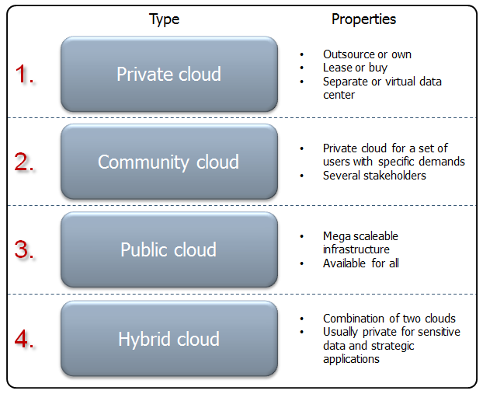
Cloud Computing Deployment models

Slide 37
Deployment Model
There are four primary cloud deployment models :
Public Cloud
Private Cloud
Community Cloud
Hybrid Cloud
Each can exhibit the previously discussed characteristics; their differences lie primarily in the scope and access of published cloud services, as they are made available to service consumers.

Slide 38
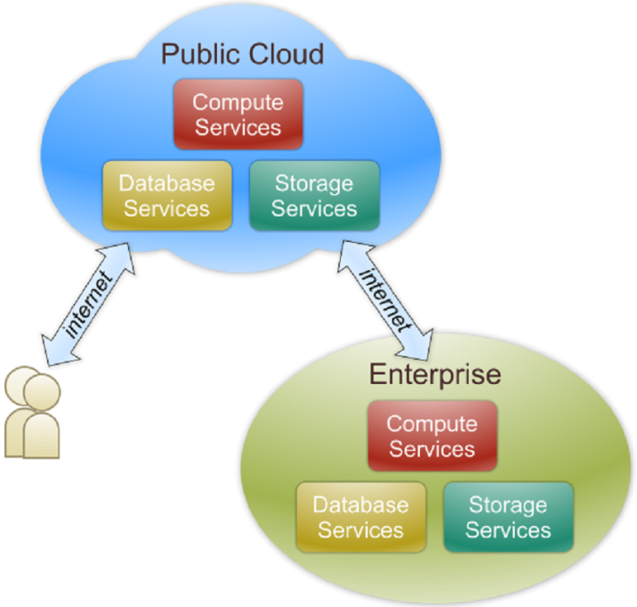
Public Cloud
Public cloud definition
The cloud infrastructure is made available to the general public or a large industry group and is owned by an organization selling cloud services.
Also known as external cloud or multi-tenant cloud, this model essentially represents a cloud environment that is openly accessible.
Basic characteristics :
Homogeneous infrastructure
Common policies
Shared resources and multi-tenant
Leased or rented infrastructure
Economies of scale

Slide 39
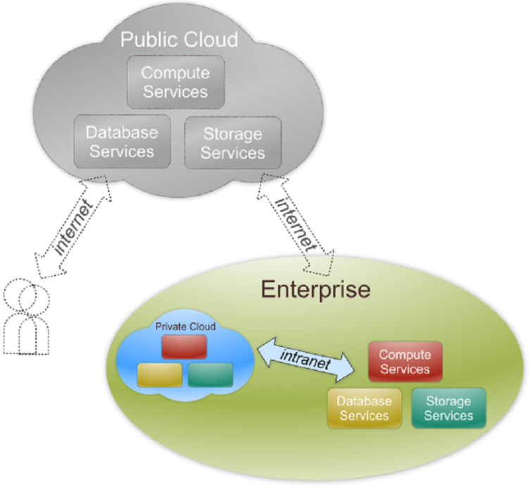
Private Cloud
Private cloud definition
The cloud infrastructure is operated solely for an organization. It may be managed by the organization or a third party and may exist on premise or off premise.
Also referred to as internal cloud or on-premise cloud, a private cloud intentionally limits access to its resources to service consumers that belong to the same organization that owns the cloud.
Basic characteristics :
Heterogeneous infrastructure
Customized and tailored policies
Dedicated resources
In-house infrastructure
End-to-end control

Slide 40
Public vs. Private
Comparison :
 | Public Cloud | Private Cloud
Infrastructure | Homogeneous | Heterogeneous
Policy Model | Common defined | Customized & Tailored
Resource Model | Shared & Multi-tenant | Dedicated
Cost Model | Operational expenditure | Capital expenditure
Economy Model | Large economy of scale | End-to-end control

Slide 41
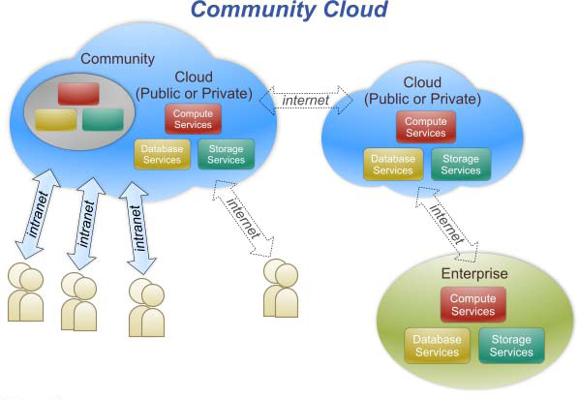
Community Cloud
Community cloud definition
The cloud infrastructure is shared by several organizations and supports a specific community that has shared concerns (e.g., mission, security requirements, policy, and compliance considerations).

Slide 42
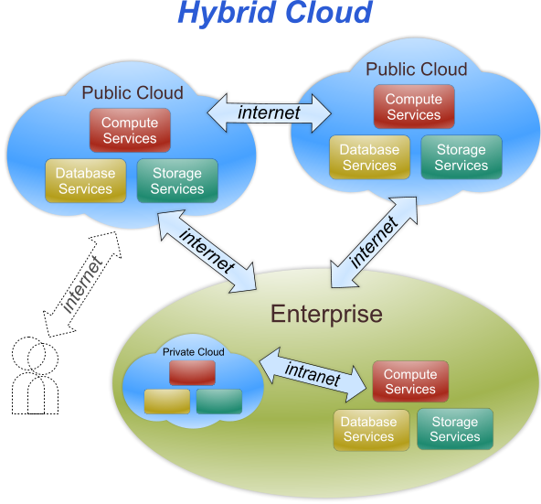
Hybrid Cloud
Hybrid cloud definition
The cloud infrastructure is a composition of two or more clouds (private, community, or public) that remain unique entities but are bound together by standardized or proprietary technology that enables data and application portability (e.g., cloud bursting for load-balancing between clouds).

Slide 43
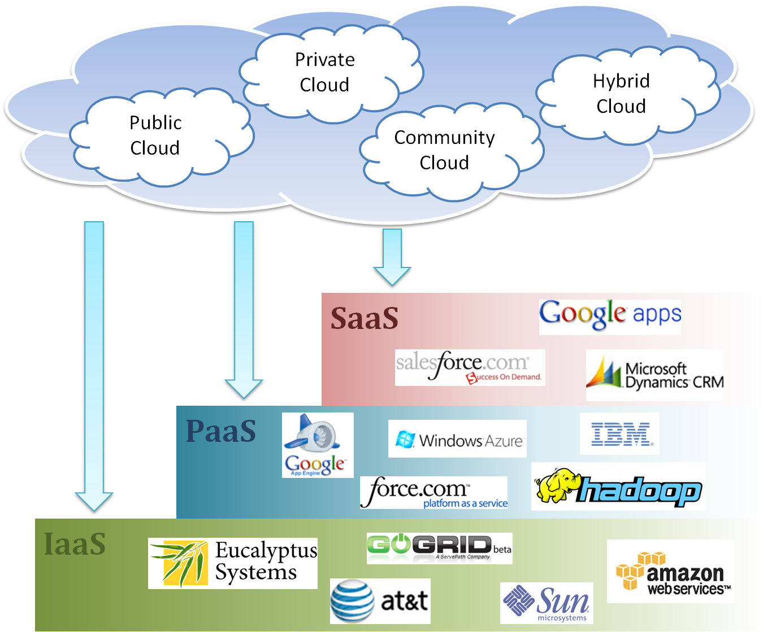
Cloud Ecosystem

Slide 44
Components of Cloud computing
Basic Components of Cloud Computing
Clients
Data center
Distributed servers

Slide 45
Components of Cloud computing
Clients : End Users
Mobile : Mobile includes PDA, Smartphones, or any other portable devices which can access internet.
Thin Clients : Now thin computers are that do not have internal hard drives or very low internal configuration, but rather the server do all there work and then display the information.
Thick Client : Regular computers, Devices that has own capabilities to do some computing.

Slide 46
Components of Cloud computing
Data Center
Now datacentre is collection of server where application to which you subscribe is housed,
it could be a large room in basement, or room full of server which you access through internet.

Slide 47
Components of Cloud computing
Distributed Severs
Server don't have to be housed in same location often server are in dispersed geographically location but to you the cloud subscriber, these server acts if they are humming right away next to each other.
This gives the service provider more flexibility in option and security.

Slide 48
Virtualization
Virtualization is the Key component of Cloud Computing.
it is the enabling technology allowing the creation of an intelligent abstraction layer which hides the complexity of underlying hardware or software.
Virtualization is the ability to run “Virtual machines’ on top of a “hypervisor”.
A hypervisor Provides a uniform abstraction of the underlying physical machine

Slide 49
What Virtual Machines provide (characteristics)
Hardware Independence
VM sees the same hardware regardless of the host hardware
Isolation
VM’s operating system is isolated from the host operating system
Encapsulation
Entire VM encapsulated into a single file

Slide 50
Virtual Machines Classification
Process Virtual Machine
Designed to run a single program, which means that it supports a single process Eg. JVM, Dalvik.
System Virtual machine
Provides a complete system platform which supports the execution of a complete operating system (OS)
Eg. VirtualBox, Parallels Workstations, Vmware, Xen etc.

Slide 51
Benefits of Using Cloud Computing
Cost Saving :
With cloud computing, you can save substantial capital costs with zero in-house server storage and application requirements.
Reliability :
cloud computing is much more reliable and consistent than in-house IT infrastructure.
Fresh Software :
The latest versions of the applications needed to run the business are made available to all customers as soon as they’re released.

Slide 52
Benefits of Using Cloud Computing
Improved Mobility :
Data and applications are available to employees no matter where they are in the world.
Flexible Capability :
Cloud is the flexible facility that can be turned up, down or off depending upon circumstances.
Less Environmental impact :
With fewer data centres worldwide and more efficient operations, we are collectively having less of an impact on the environment.

Slide 53
Legal issues in Using Cloud Models
Addressing Privacy and Security Concerns
The cloud model has been highly criticized for risk of data privacy and security breaches. many countries throughout the world, there are numerous privacy laws at both the Federal and local (state or provincial) levels.
Cloud computing contracts and cloud outages
When a cloud service goes down, users lose access to their data and therefore may be unable to provide services to their customers. When is a cloud user compensated for the loss of service, and to what extent? Users need to examine how cloud computing contracts account for cloud outages.

Slide 54
Cloud Computing Characteristics
Common Characteristics:
Massive Scale
Resilient Computing
Homogeneity
Geographic Distribution
Virtualization
Service Orientation
Low Cost Software
Advanced Security
Essential Characteristics:
On Demand Self-Service
Broad Network Access
Rapid Elasticity
Resource Pooling
Measured Service
Adopted from: Effectively and Securely Using the Cloud Computing Paradigm by peter Mell, Tim Grance
Notes:
ResiliencyCloud providers have mirrored solutions to minimize downtime in the event of a disaster.
Characteristic - a special quality or trait that makes a person, thing, or group different from others. Feature - an interesting or important part, quality, ability, etc

Slide 55
Characteristics of Cloud computing
five essential characteristics of cloud computing:
On demand self-service
Broad network access
Resource pooling
Rapid Elasticity
Measured service

Slide 56
On-demand self-service:
A consumer can unilaterally provision computing capabilities, such as server time and network storage, as needed automatically without requiring human interaction with each service provider.

Slide 57
Broad network access:
Capabilities are available over the network and accessed through standard mechanisms that promote use by heterogeneous thin or thick client platforms (e.g., mobile phones, tablets, laptops and workstations).

Slide 58
Resource pooling:
The provider's computing resources are pooled to serve multiple consumers using a multi-tenant model, with different physical and virtual resources dynamically assigned and reassigned according to consumer demand.
There is a sense of location independence in that the customer generally has no control or knowledge over the exact location of the provided resources but may be able to specify location at a higher level of abstraction (e.g., country, state or datacenter).
Examples of resources include storage, processing, memory and network bandwidth.
Notes:
Multi-tenancy is an architecture in which a single instance of a software application serves multiple customers. Each customer is called a tenant.

Slide 59
Rapid elasticity:
Capabilities can be elastically provisioned and released, in some cases automatically, to scale rapidly outward and inward commensurate with demand.
To the consumer, the capabilities available for provisioning often appear to be unlimited and can be appropriated in any quantity at any time.

Slide 60
Measured service:
Cloud systems automatically control and optimize resource use by leveraging a metering capability at some level of abstraction appropriate to the type of service (e.g., storage, processing, bandwidth and active user accounts).
Resource usage can be monitored, controlled and reported, providing transparency for the provider and consumer.

Slide 61
Cloud computing shares characteristics with:
Autonomic computing
Client–server model
Grid computing
Mainframe computer
Utility computing
Peer-to-peer
Service-oriented computing

Slide 62
Challenges of Cloud Computing
Security and Privacy
Data security and privacy has been always the challenge in cloud computing.
there may be some data or applications that your organization will never feel comfortable letting out of sight.
Lack of Standards
There is no standard associated with cloud computing.
The Open Grid Forum is developing an Open Cloud Computing Interface to resolve this issue and the Open Cloud Consortium is working on cloud computing standards and practices

Slide 63
Challenges of Cloud Computing
Continuously Evolving
User requirements are continuously evolving, as are the requirements for interfaces, networking, and storage. So Cloud has to grow accordingly to meet all the requirements for interfaces, networking, storages etc.
Integration with Existing Infrastructure:
This is a difficult yet essential piece of maximizing the value of cloud services.
Vendor Transparency:
“Trust me” is not what you want to hear from your service provider.

Slide 64
Challenges of Cloud Computing
Performance and Bandwidth Cost:
Cloud computing is impossible if you cannot connect to the Internet.
Since you use the Internet to connect to both your applications and documents, if you do not have an Internet connection you cannot access anything, even your own documents. And slow internet is painful.
A dead Internet connection means no work and in areas where Internet connections are few or inherently unreliable, this could be a deal-breaker.
For smaller applications this is not usually an issue, but cost can be high for the data-intensive applications.

Slide 65
Distributed Computing
A distributed system is a network of autonomous computers that communicate with each other in order to achieve a goal.
The computers in a distributed system are independent and do not physically share memory or processors.
hey communicate with each other using messages, pieces of information transferred from one computer to another over a network.

Slide 66
Distributed computing
Computers in a distributed system can have different roles. A computer's role depends on the goal of the system and the computer's own hardware and software properties.
There are two predominant ways of organizing computers in a distributed system. The first is the client-server architecture, and the second is the peer-to-peer architecture.

Slide 67
Distributed vs Parallel Computing
In parallel computing, all processors may have access to a shared memory to exchange information between processors.
In distributed computing, each processor has its own private memory (distributed memory). Information is exchanged by passing messages between the processors.

Slide 68
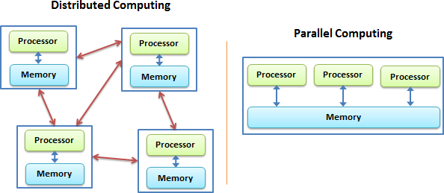
Distributed vs Parallel Computing

Slide 69
Cloud service requirements
Efficiency / cost reduction
Data security
Scalability
Mobility
Disaster recovery
Control
Market reach
Automatic Software Updates

Slide 70
1. Efficiency / cost reduction
By using cloud infrastructure, you don’t have to spend huge amounts of money on purchasing and maintaining equipment.
2. Data security
Cloud offers many advanced security features that guarantee that data is securely stored and handled. Cloud storage providers implement baseline protections for their platforms and the data they process, such authentication, access control, and encryption.
3. Scalability
Different companies have different IT needs — a large enterprise of 1000+ employees won’t have the same IT requirements as a start-up.Using cloud is a great solution because it enables enterprise to efficiently — and quickly — scale up/down according to business demands.

Slide 71
4. Mobility
Cloud computing allows mobile access to corporate data via smartphones and devices, which is a great way to ensure that no one is ever left out of the loop. Staff with busy schedules, or who live a long way away from the corporate office, can use this feature to keep instantly up-to-date with clients and coworkers.
5. Disaster recovery
Data loss is a major concern for all organizations, along with data security. Storing your data in the cloud guarantees that data is always available, even if your equipment like laptops or PCs, is damaged. Cloud-based services provide quick data recovery for all kinds of emergency scenarios.
6. Control
Cloud enables you complete visibility and control over your data. You can easily decide which users have what level of access to what data.

Slide 72
7. Market reach
Developing in the cloud enables users to get their applications to market quickly.
8. Automatic Software Updates
Cloud-based applications automatically refresh and update themselves.

Slide 73
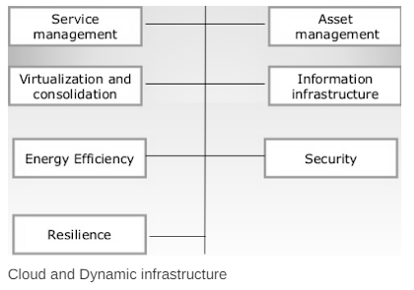
Cloud and dynamic infrastructure

Slide 74
1. Service management
This type of special facility or a functionality is provided to the cloud IT services by the cloud service providers. This facility includes visibility, automation and control to delivering the first class IT services.
2. Asset-Management
In this the assets or the property which is involved in providing the cloud services are getting managed.
3. Virtualization and consolidation
Consolidation is an effort to reduce the cost of a technology by improving its operating efficiency and effectiveness. It means migrating from large number of resources to fewer one, which is done by virtualization technology.

Slide 75
4. Information Infrastructure
It helps the business organizations to achieve the following : Information compliance, availability of resources retention and security objectives.
5. Energy-Efficiency
Here the IT infrastructure or organization sustainable. It means it is not likely to damage or effect any other thing.
6. Security
This cloud infrastructure is responsible for the risk management. Risk management Refers to the risks involved in the services which are being provided by the cloud-service providers.
7. Resilience
This infrastructure provides the feature of resilience means the services are resilient. It means the infrastructure is safe from all sides. The IT operations will not be easily get affected.

Slide 76
Cloud adoption
Cloud Adoption is a strategic move by organizations of reducing cost, mitigating risk and achieving scalability of data base capabilities. Cloud adoption may be up to various degrees in an organization, depending on the depth of adoption.
Here Cloud means the environment of cloud where the cloud services are being operated.
Adoption term states that accepting the services of new Technology.
Adoption means following some kind of new trend or existing trend or a technology.
This Cloud adoption is suitable for low priority business applications.
It supports some interactive applications that combines two or more data sources.

Slide 77
For example:-if a marketing company requires to grow his business in the whole country in a short span of time then it must need a quick promotion or short promotion across the country.
Cloud Adoption is useful when the recovery management, backup recovery based implementations are required.
By considering the above key points we conclude that it is only suitable for the applications that are modular and loosely coupled.
It will work well with research and development projects.

Slide 78
Cloud storage
Cloud storage is a cloud computing model that stores data on the Internet through a cloud computing provider who manages and operates data storage as a service. It’s delivered on demand with just-in-time capacity and costs, and eliminates buying and managing your own data storage infrastructure. This gives you agility, global scale and durability, with “anytime, anywhere” data access.

Slide 79
How Does Cloud Storage Work?
Cloud storage is purchased from a third party cloud vendor who owns and operates data storage capacity and delivers it over the Internet in a pay-as-you-go model. These cloud storage vendors manage capacity, security and durability to make data accessible to your applications all around the world.
Applications access cloud storage through traditional storage protocols or directly via an API. Many vendors offer complementary services designed to help collect, manage, secure and analyze data at massive scale.

Slide 80
Benefits of Cloud Storage
Total Cost of Ownership. With cloud storage, there is no hardware to purchase, storage to provision, or capital being used for "someday" scenarios. You can add or remove capacity on demand, quickly change performance and retention characteristics, and only pay for storage that you actually use. Less frequently accessed data can even be automatically moved to lower cost tiers in accordance with auditable rules, driving economies of scale.
Time to Deployment. When development teams are ready to execute, infrastructure should never slow them down. Cloud storage allows IT to quickly deliver the exact amount of storage needed, right when it's needed. This allows IT to focus on solving complex application problems instead of having to manage storage systems.
Information Management. Centralizing storage in the cloud creates a tremendous leverage point for new use cases. By using cloud storage lifecycle management policies, you can perform powerful information management tasks including automated tiering or locking down data in support of compliance requirements.

Slide 81
Types of Cloud Storage
There are three types of cloud data storage: object storage, file storage, and block storage. Each offers their own advantages and have their own use cases:
Object Storage - Applications developed in the cloud often take advantage of object storage's vast scalablity and metadata characteristics. Object storage solutions like Amazon Simple Storage Service (S3) are ideal for building modern applications from scratch that require scale and flexibility, and can also be used to import existing data stores for analytics, backup, or archive.
File Storage - Some applications need to access shared files and require a file system. This type of storage is often supported with a Network Attached Storage (NAS) server. File storage solutions like Amazon Elastic File System (EFS) are ideal for use cases like large content repositories, development environments, media stores, or user home directories.
Block Storage - Other enterprise applications like databases or ERP systems often require dedicated, low latency storage for each host. This is analagous to direct-attached storage (DAS) or a Storage Area Network (SAN). Block-based cloud storage solutions like Amazon Elastic Block Store (EBS) are provisioned with each virtual server and offer the ultra low latency required for high performance workloads.

Slide 82
Communication as a Service
What is Cloud communication?
Cloud communications are Internet-based voice and data communications where telecommunications applications, switching and storage are hosted by a third-party outside of the organization using them, and they are accessed over the public Internet.
Cloud communications providers deliver voice and data communications applications and services, hosting them on servers that the providers own and maintain, giving their customers access to the “cloud.”
customers have a more cost-effective, reliable and secure communications environment, without the headaches associated with more conventional PBX system deployment.
Notes:
A PBX (private branch exchange) is a telephone system within an enterprise that switches calls between enterprise users on local lines while allowing all users to share a certain number of external phone lines.

Slide 83
Communication as a Service
Cloud communications contd.
Services include distributed call centres and economical teleworking.
For a small or medium-sized business, the capital investment to set up VoIP infrastructure in-house could be too high compared to the potential return, but cloud telephony could offer the same services on a lower-cost subscription basis.
Examples: BluIP, Nextiva etc.

Slide 84
Communication as a Service
Communications as a Service (CaaS) provides Software as a Service (SaaS) for communications.
There is no standard specification as to what is included in CaaS. Implementations vary.
CaaS could include unified communications, broadcasting, individual calls (voice and video), conferencing (voice and video), voice over IP (VoIP), messaging, and so on

Slide 85
Communication as a Service
The CaaS vendor is responsible for all hardware and Software management and offers guaranteed Quality of Service (QoS).
CaaS allows businesses to selectively deploy communications devices and modes on a pay-as-you-go, as-needed basis.
This approach eliminates the large capital investment and ongoing overhead for a system whose capacity may often exceed or fall short of current demand.

Slide 86
Advantages of Communication as a Service (CaaS)
Fully Integrated Enterprise Class Unified Communication:
No Upfront Capital Expenses:
Flexibility in Features:
No Risk of Obsolescence:
Guaranteed Business Continuity:

Slide 87
Advantages of Communication as a Service (CaaS)
Fully Integrated Enterprise Class Unified Communication:
By managing the LAN/WAN, the vendor can guarantee consistent Quality of Service (QoS) from the desktop across the VoIP backbone and back again.
Advanced Unified Communications features such as Outlook integration, soft phones, real-time presence, chat, multimedia conferencing, video calling, unified messaging and mobility are also part of a standard CaaS deployment.
Development and introduction of new features and applications are faster, easier and more economical because the service provider is doing the work for multiple end users across a scalable platform.

Slide 88
Unified Communications
Unified communications (UC) is a business term describing the integration of enterprise communication services.
communications integrated to optimize business processes and increase user productivity.
Unified communications is an evolving set of technologies that automates and unifies human and device communications in a common context and experience.

Slide 89
Unified Communications
In its broadest sense, UC can encompass all forms of communications that are exchanged via a network to include other forms of communications such as Internet Protocol Television (IPTV)and digital signage Communications
Notes:
signage is the design or use of signs and symbols to communicate a message to a specific group( LED panel display)

Slide 90
Advantages of Communication as a Service (CaaS)
No Upfront Capital Expenses:
Since cloud services are supposed to lower capital expenditure and focus more on operating expenditure, by implementing CaaS, consumers can build up their communication infrastructure without any upfront cost. They just need to pay it as a service.
Flexibility in Features:
Since cloud is a multi-tenant architecture, cloud vendors have to manage multiple customers and look after the features that they want. What this allows cloud vendor is to add more advanced features and flexibility in their service model.

Slide 91
Advantages of Communication as a Service (CaaS)
No Risk of Obsolescence:
Technology changes rapidly and are obsolete within few years of introduction. With CaaS, companies are always privileged with new technologies as cloud vendors keep on updating their equipment’s and technologies to sustain in market.
Guaranteed Business Continuity:
With CaaS, organization can be hugely benefitted with guaranteed business continuity as cloud service providers proactively plans for Business Continuity Planning for their customers. Service uptime is guaranteed even if any catastrophic disaster strikes.

